Slide 1

18ECE340T- MACHINE PERCEPTION WITH COGNITION
UNIT-2
Topics Covered: Distance Functions, Skeleton and Thinning, Deformable shape analysis and Boundary tracking procedures
Reference Book
Computer and Machine Vision by E.R.Davies
Prepared by
Dr. S.UMA MAHESWARI,
Assistant Professor/ ECE

Slide 2
DISTANCE FUNCTIONS AND THEIR USES

Slide 3
Distance Functions
The distance measurements is that between two specified pixels (x1,y1) and (x2,y2).

Slide 4
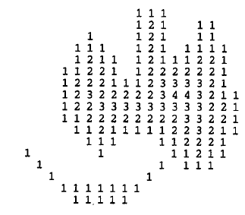
Distance Functions
Each pixel in the object is numbered according to its distance from the background.
Background Pixel as 0.
Edge Pixel is counted as 1.
Object pixels next to 1’s become 2’s, next to those are the 3’s and so on throughout all the object pixels as shown in Figure.

Slide 5
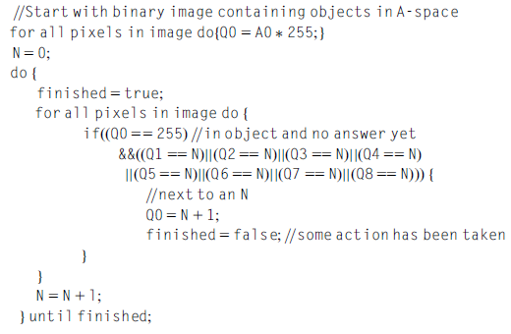
A Parallel Algorithm for propagating Distance Functions

Slide 6

A Parallel Algorithm for propagating Distance Functions
It is possible to perform the propagation of a distance function with far fewer operations if sequential processing is used. In 1-D, the basic idea would be to build up ramps within objects using a routine like the following:

Slide 7

Local Maxima and Data Compression
An interesting application of distance functions---→data compression
Operations are carried out to locate the pixels that are local maxima of the distance function
since storing these pixel values and positions permits the original image to be regenerated by a process of downward propagation
To locate the local maxima, the following parallelroutine may be employed:

Slide 8
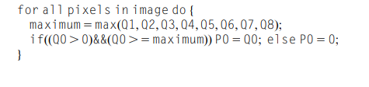
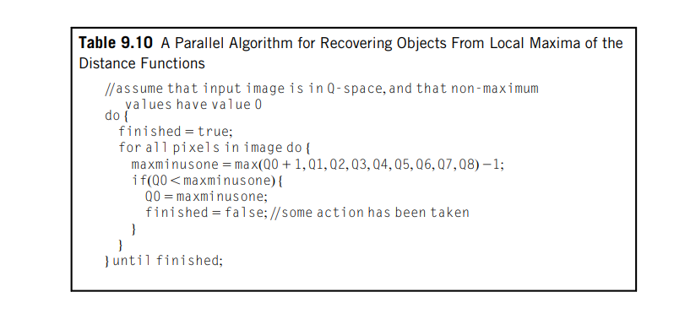
The compressed data can be transferred to a single image space:

Slide 9
Local Maxima and Data Compression
As a result of this, it is found that the local maxima group themselves into clusters of connected points, each cluster having a common distance value and being separated from points of different distance.
The set of local maxima of an object is not a connected subset. This fact has an important bearing on skeleton formation.
A parallel downward propagation algorithm (Table 9.10) for recovering the shapes of objects from an image into which the values of the local maxima have been inserted.

Slide 10

Skeletons and Thinning
The skeleton is the framework that provides structure to the rest of the body and facilitates movement.
USES:
Analysis and Description of shapes in binary images.
DEFINITION:
A skeleton may be defined as a connected set of medial lines along the limbs of a figure.
EXAMPLE:
Thick hand-drawn characters:
The skeleton be supposed to be the path traveled by the pen.
BASIC IDEA:
Eliminating redundant information while retaining only the topological information concerning the shape and structure of the object that can help with recognition.

Slide 11
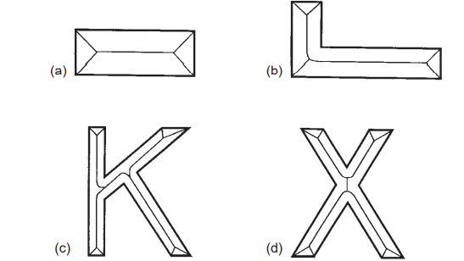
FINDING THE LOCI:
1.Angle bisectors
2.Lines
3.Parabolas
DRAWBACK OF LOCAL MAXIMA:
Does not form a connected graph within a given object nor is it necessarily composed of thin lines

Slide 12
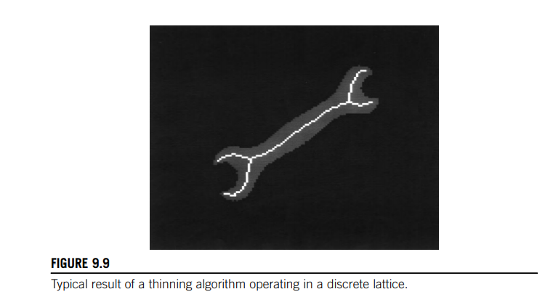
An alternative idea—that of thinning
DEFINITION:
Defined as the process of systematically stripping away the outermost layers of a
figure until only a connected unit-width skeleton remains.
To discuss the mechanism by which points on the boundary of a figure may validly be removed in thinning algorithms

Slide 13
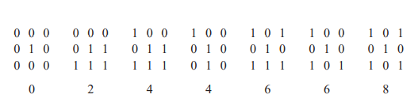

1.Crossing Number
EXAMPLE:
Formula for χ is made more complex by the 8-connectedness criterion :

Slide 14
EXAMPLE:
0 1 0
0 1 1
1 1 1
MODIFIED FORMULA:

Slide 15
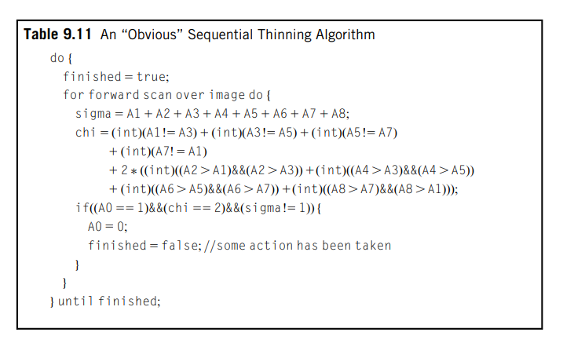
2.Parallel and Sequential Implementations of Thinning
sequential thinning algorithm:

Slide 16
STEP:1
FIRST PASS: Mark edge points over an image.
STEP:2
SECOND PASS: strip points sequentially as in the above algorithm, but only where they have already been marked.then mark a new set of edge points.
STEP:3
Then perform another stripping pass; then repeat this marking and stripping sequence until no further change.

Slide 17
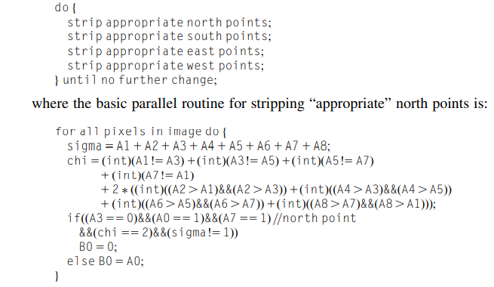
Parallel thinning algorithm
Parallel algorithms result in several points being removed at once.
A parallel thinning algorithm in rectangular tessellation is the following:

Slide 18
DRAWBACKS AND PROBLEM
1. The problem of skeletal bias;
2. The problem of eliminating skeletal lines along certain limbs;
3. The problem of introducing “noise spurs”;
4. The problem of slow speed of operation

Slide 19
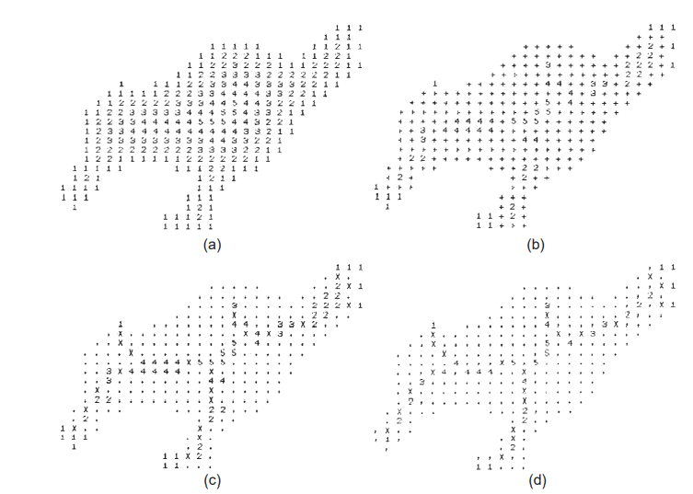
3.Guided Thinning
GUIDED THINNING ALGORITHM:

Slide 20
(a) distance function on the original shape
(b) set of local maxima
(c) set of local maxima now connected by a simple thinning algorithm
(d) final thinned skeleton. The effect of removing noise spurs systematically, by cutting limbs terminating in a 1 back to the next local maximum, is easily discernible from the result in (d): the general shape of the object is not perturbed by this process.

Slide 21
4.A Comment on the Nature of the Skeleton
1.EXAMPLE: Character recognition
Stated that the skeleton may be supposed to be the path traveled by the pen in drawing out the character.
2. Take the case of a letter K.
The vertical limb on the left of the skeleton theoretically consists of two linear segments joined by two parabolic segments leading into the junction. This limb will only become straight if a higher level model is used to constrain the result.

Slide 22
5. Skeleton Node Analysis
The aid of the crossing number concept.
modified crossing number χskel 5 2σ,
DRAWBACK:
insufficient resolution

Slide 23
6. Application of Skeletons for Shape Recognition
The classification of simple shapes
The analysis of the shapes of chromosomes
To check for items such as defects

Slide 24
Deformable shape analysis
A method for deformable shape detection and recognition is described.
Deformable shape templates are used to partition the image into a globally consistent interpretation
determined in part by the minimum description length principle
Statistical shape models enforce the prior probabilities on global, parametric deformations for each object class.
Once trained, the system autonomously segments deformed shapes from the background, while not merging them with adjacent objects or shadows.
The formulation can be used to group image regions obtained via any region segmentation algorithm, e.g., texture, color, or motion.
The recovered shape models can be used directly in object recognition.
Experiments with color imagery are reported

Slide 25
BOUNDARY TRACKING PROCEDURES
Methods of analyzing shape on the basis of body representations such as skeletons and moments.
Boundary pattern analysis:
ADVANTAGE: Reduced computation
DISADVANTAGE: The number of pixels to be examined is equal to the number of pixels on the boundary of any object rather than the much larger number of pixels within the boundary.
Objects having unit width in certain places maybecome disconnected.

Slide 26
There is still a problem when objects have unit-width sections
since these can cause badly designed tracking algorithms to choose a wrong path, going back around the previous section instead of on to the next
To avoid this circumstance it is best to adopt the following strategy:
1. track round each boundary, keeping to the left path consistently
2. stop the tracking procedure only when passing through the starting point in the original direction (or passing through the first two points in the same order).

Slide 27
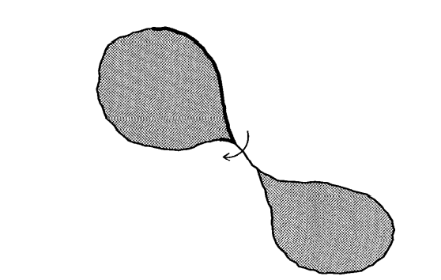
Boundary tracking algorithm
A problem with an over-simple boundary tracking algorithm
The boundary tracking procedure takes a short-cut across a unit-width boundary segment instead of continuing
and keeping to the left path at all times

